Slide 1
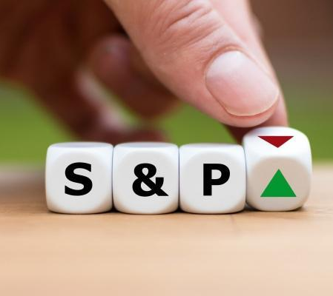
Can we predict the S&P500 ?

Slide 2
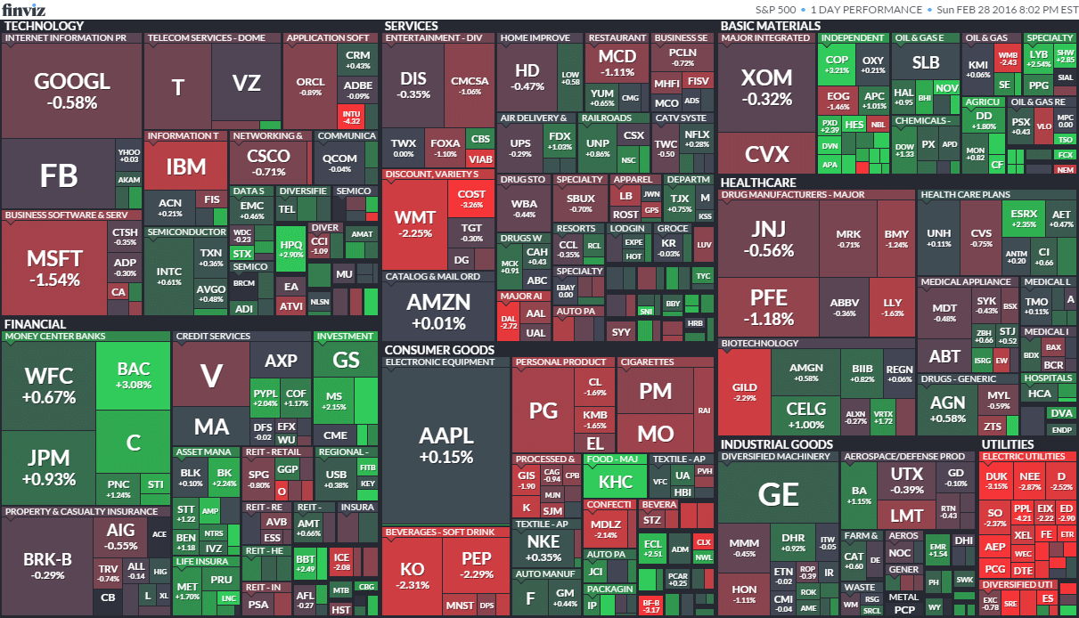
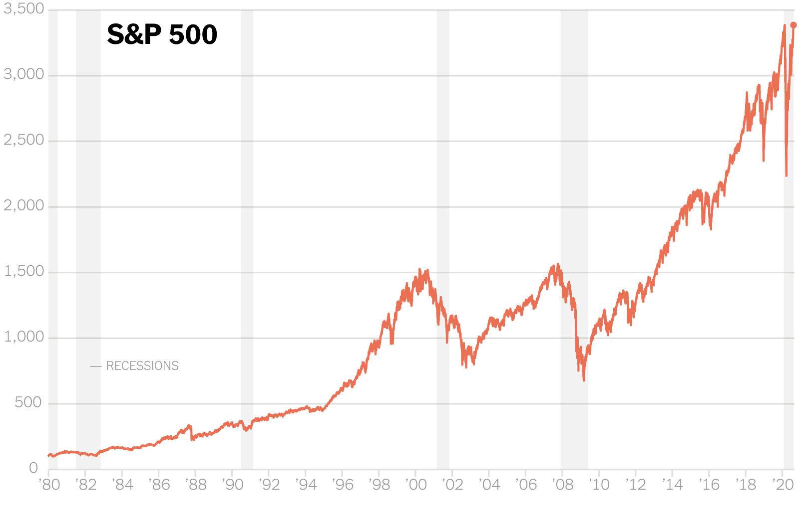
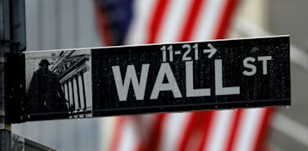
S&P 500 INEDx backround
The S&P 500 index is a capitalization-weighted index and the 10 largest companies in the index account for 27.5% of the market capitalization of the index.
The S&P 500 is a free-float weighted measurement stock market index of 500 of the largest companies listed on stock exchanges in the United States. It is one of the most followed equity indices.
The index is associated with many ticker symbols, including: ^GSPC, INX, and $SPX, depending on market or website. The index value is updated every 15 seconds, or 1,559 times per trading day, with price updates disseminated by Reuters.

Slide 3
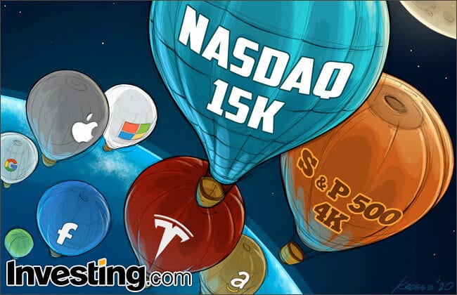
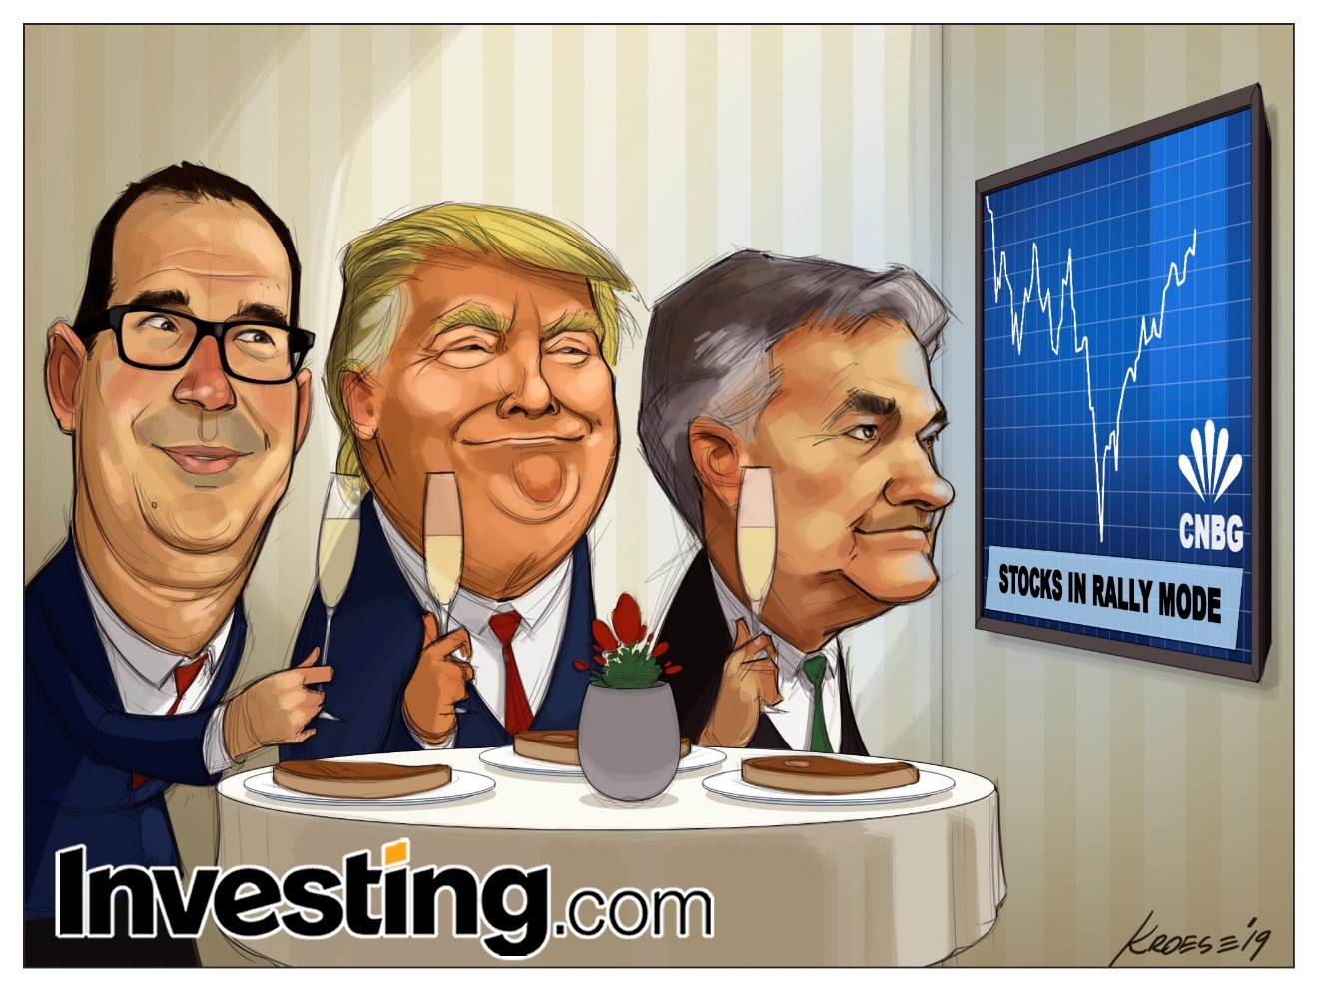
Research questions
Can we predict the price or movement of the s&p500 index.
Is it passible to predicate the outcome of the average movement percentage

Slide 4
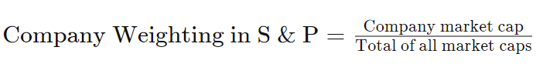
S&p 500 History
1860
In 1860, Henry Varnum Poor formed Poor's Publishing, which published an investor's guide to the railroad industry.
1923
In 1923, Standard Statistics Company began rating mortgage bonds and developed its first stock market index consisting of the stocks of 233 U.S. companies, computed weekly.
Mon. 4 Mar. 1957
On Monday, March 4, 1957 the index was expanded to its current 500 companies and was renamed the S&P 500 Stock Composite Index.
1962
In 1962, Ultronic Systems became the compiler of the S&P indices including the S&P 500 Stock Composite Index, the 425 Stock Industrial Index, the 50 Stock Utility Index, and the 25 Stock Rail Index.
1976 31 Aug.
On August 31, 1976, The Vanguard Group offered the first mutual fund to retail investors that tracked the index.
The S&P 500 uses a market capitalization weighting method, giving a higher percentage allocation to companies with the largest market capitalizations.1﻿
Weighting Formula and Calculation for the S&P 500

Slide 5
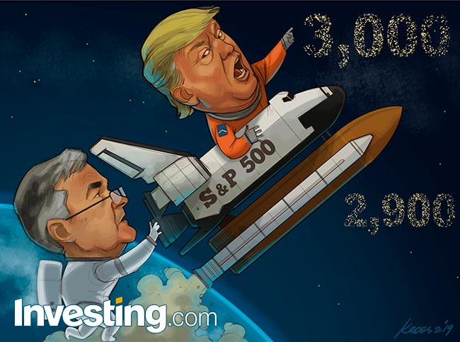
Investing in the S&P 500
The easiest way to invest in the S&P 500 is to buy an index fund, either a mutual fund or an exchange-traded fund that replicates, before fees and expenses, the performance of the index by holding the same stocks as the index, in the same proportions. Exchange-traded funds (ETFs) that replicate the performance of the index
An index fund (also index tracker) is a mutual fund or exchange-traded fund (ETF) designed to follow certain preset rules so that the fund can track a specified basket of underlying investments
Some offers leveraged ETFs that attempt to produce 3x the daily result of either investing in (NYSE Arca: SPXL) or shorting (NYSE Arca: SPXS) the S&P 500 index.

Slide 6
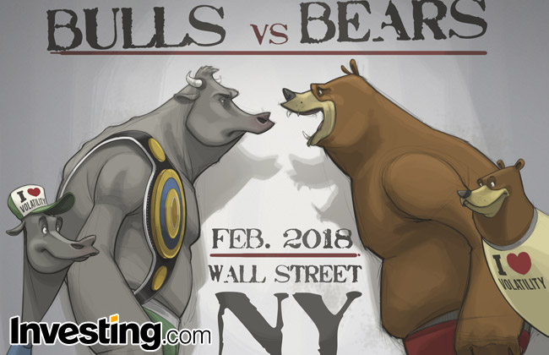
Performance of the s&p 500.
For nearly the last century, the average annual total return of the S&P 500 (which includes dividends) has been about 10%, not adjusting for inflation. However, keep in mind this doesn’t mean you can expect to get a 10% return on your investment in an S&P 500 index fund every year.
In 2008, for example, the S&P 500 finished the year down a staggering 37%. The following year, it finished up 26%. Earning a 10% average annual total return requires a long-term investing mindset and a willingness to ride out market volatility. Learn more about average stock market returns here.
The average annual total return and compound annual growth rate of the index, including dividends, since inception in 1926 has been approximately 9.8%, or 6% after inflation; however, there were several years where the index declined over 30%.The index has posted annual increases 70% of the time. However, the index has only made new highs on 5% of trading days, meaning that on 95% of trading days, the index has closed below its all-time high.

Slide 7
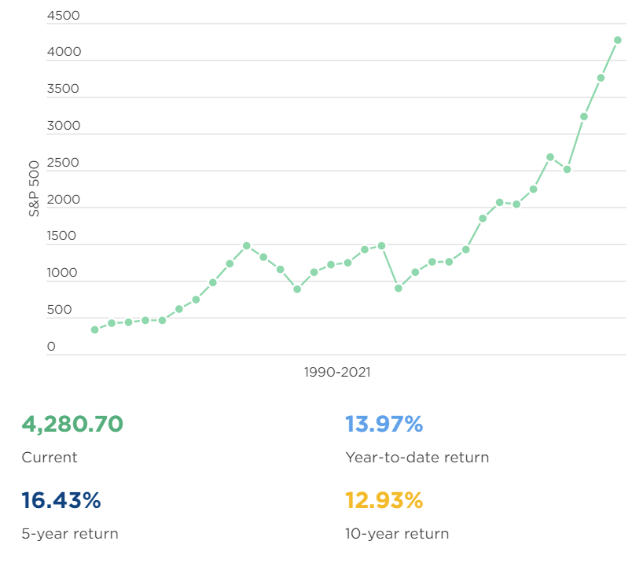
The S&P 500 index today
The chart shows how the S&P 500 has performed since 1990, up to the previous close of the current year. This demonstrates how the index has increased over the long term, despite some decreases year-to-year during the period.

Slide 8
Basics Trading
Trading the index requires buying an asset, which is directly derived from the index. Many brokers replicate the S&P 500 index with a derivative product called CFD (Contract for difference), which is an agreement between two parties to exchange the difference between the opening price and closing price of a contract.
Example: Buy 1 CFD S&P 500 at Open (value is 2000), sell it at Close of the day (value is 2020). The difference, hence the gain, is 20 points. If each point has a value of $25
Another important aspect to consider is to avoid significant losses within a trade , A stop loss order must be placed to protect against a maximum loss we would tolerate within a trade, and such an order is triggered whenever the price of the asset goes below a fixed value we have set before.

Slide 9
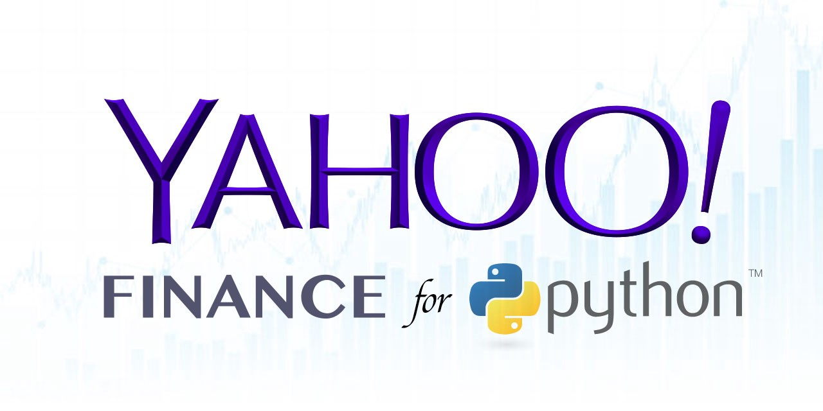
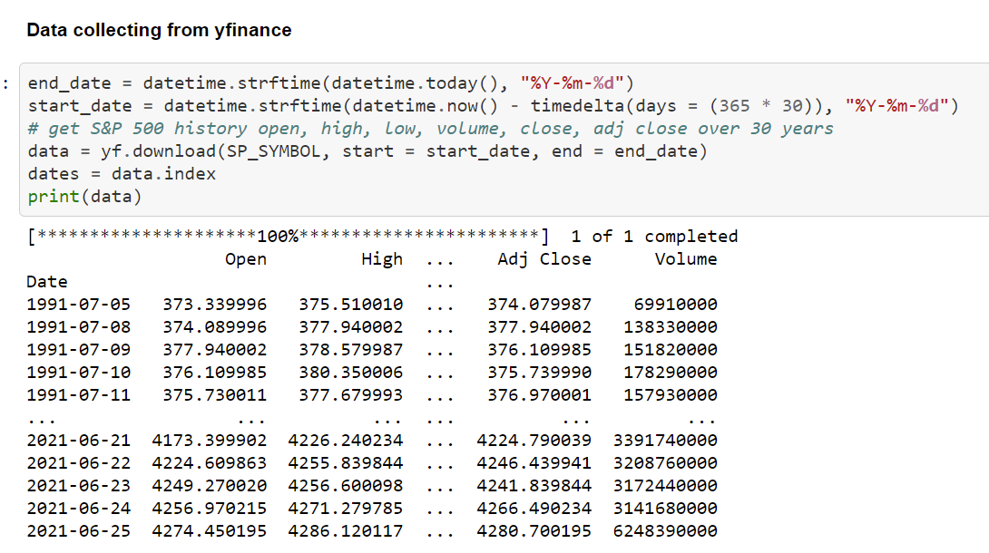
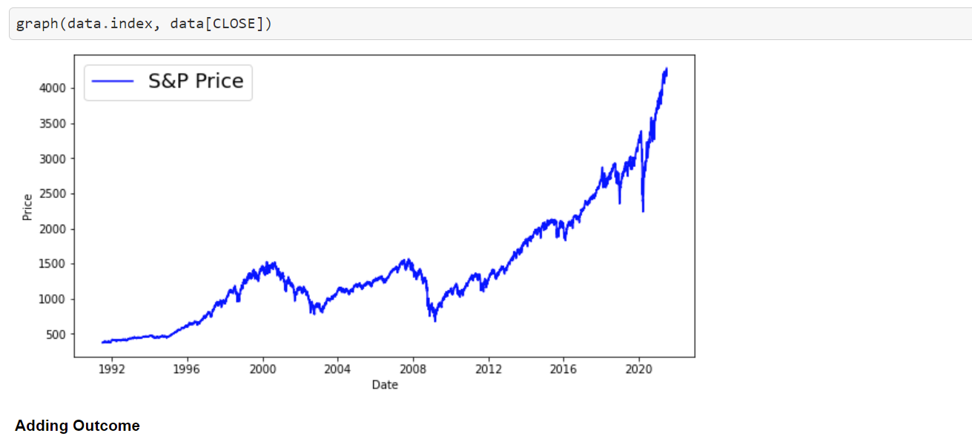
API
We used Python for Machine Learning code, using historical data from Yahoo Finance service. As mentioned before, historical data is necessary to train the model before making our predictions.

Slide 10
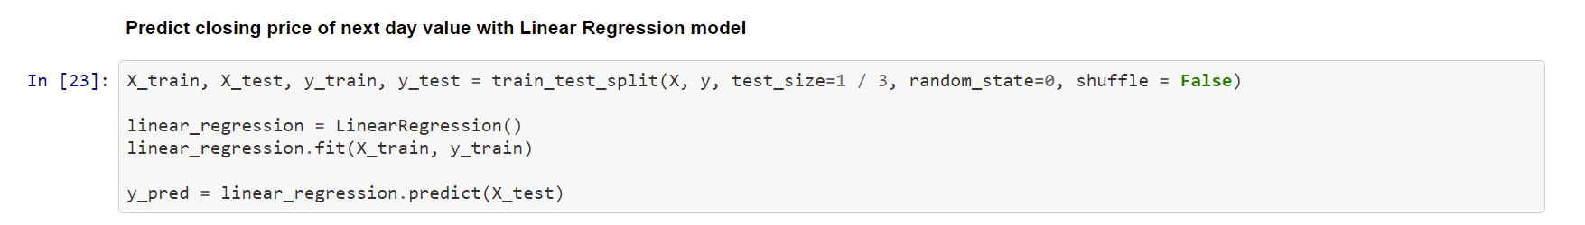
Training Some Machine Learning Models
The goal of each model is to predict if the closing price will be higher than the opening price. Hence, in that case, we can achieve a positive return when buying the underlying asset .
Training a Linear Regression Model : The main difference of this model is that it deals with continuous values instead of binary classes, as mentioned before. We don’t have to train the model with a target variable equal to +1 for Up days and -1 for Down days, our target must be a continuous variable. Since we want to predict a positive gain, or in other words a Closing price higher than the Opening price, now target must be the gain column of our training set. Also, the list of features must be composed of continuous values, such as the previous Open, Close, etc.
Decision Tree Model - SVM Model - Naive Bayes Model :
the goal of each model is to predict if the closing price will be higher than the opening price

Slide 11
Classification Models Attributes
# distance between Highest and Opening price
# distance between Lowest and Opening price
# distance between Closing and Opening price
Linear Regression Model Attributes
OPEN - The opening price is the price at which a security first trades upon the opening of an exchange on a trading day.
HIGH - a high stock price a day.
LOW – the lowest price for the stock.
VOLUME - Volume refers to the amount of shares or contracts traded in an asset or security over a period of time, usually over the course of a trading day.

Slide 12
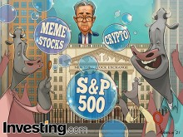
The results
Decision Tree Model – 50.93%
Logistic Regression Model – 53.11%
SVM Model – 54.66%
Naive Bayes Model – 53.03%
Percentages of accuracy in the prediction of the models .

Slide 13
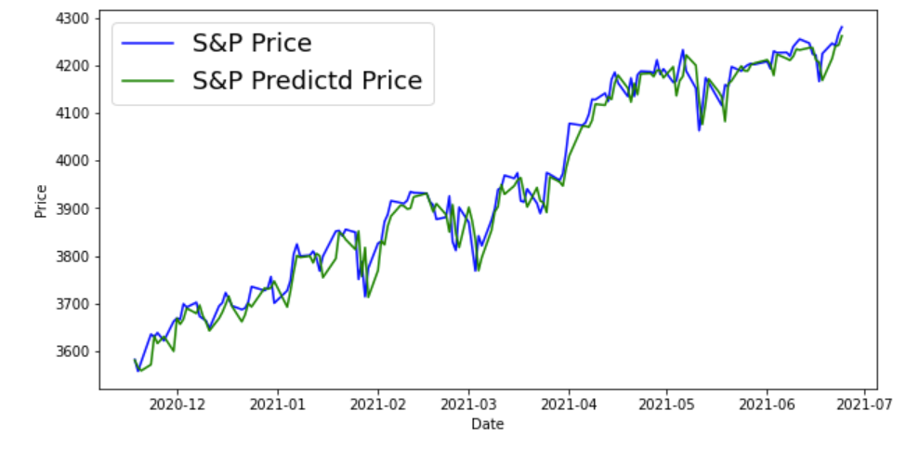
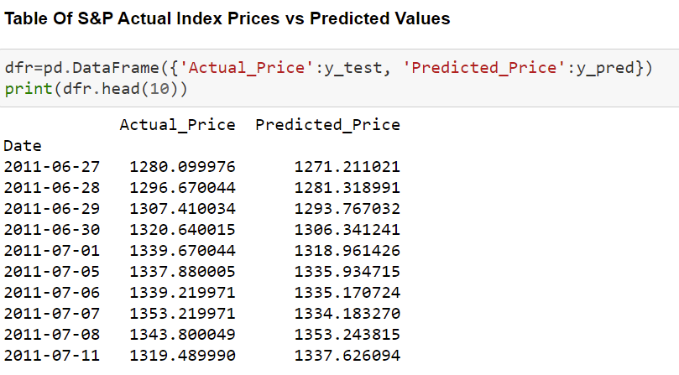
Conclusion
Even in the financial world, Machine Learning is welcomed as a powerful instrument to learn from data and give us great forecasting tools. Each model shows different values of accuracy and precision, but in general, all models can be aggregated to achieve a better result than each one of them taken singularly

Slide 14
github
https://github.com/ofekag/S-P-Predictions.git

Slide 15
חשיבות שאלת המחקר שלנו .
בעזרת העבודה שלנו אפשר לראות כי מאוד קשה לחזות את שוק ההון ואפשר להבין כי חיזוי השוק הוא דבר שקשה מאוד לעשות מכיון שאם היה מתאפשר אז הדרך לעושר הייתה מהירה מתמיד .
במהלך העבודה נתקלנו במספר קשיים .
בנסיון להגדיל את תאריכי החיזוי נתקלנו בקשיים שהרי ברגע שטווח החיזוי עולה ניתן לראות כי הדיוק יורד לאחוזים שלא ישרתו אותנו .
אפשר להבין כי בעזרת חיזוי והעבודה עם בסיס נתונים אפשר "לחזות" אם כי במידה מסויימת את שוק הוון .
תחום זה נקרא מסחר אלגו טריידינג .
התום הולך ומתפתח ודורש הבנה מעמיקה הן בשוק ההון והן בתחום מידע נתונים וכמובן בלמידת מכונה .
במחקר פעלנו על הנתונים המייבואים מיאהו פאייננס. מספר מודלים ובעזרתם הגענו לחיזוי .
כמובן לאחר שלב הבדיקה ולימוד המוכנה יכולנו להריץ את המודל על "זמן אמת " כמובן שהכל בדיעבד .
שאלת המחקר שלנו יכולה לשרת אתם הסוחר בשוק ההון ויכולה לתת את ניתוח המחשב בכדי להבין ולקבל דאטה נוסף לכיון השוק .
מידע זה יכול ולעזור במסחר .

